Slide 1
Using the Writing Range Finder Approach to Understand and Improve Student Writing.
Presenters: Jay DiMartino, Brian Spivey, Diane Plowden, Juliette Carter, Mary Navarre, Michelle Townley, and Paul Holimon

Slide 2
What are we going to do today?
Simplify and specify the language in the text-based writing FSA rubric to better understand how to evaluate student writing.
Score and discuss two student essays to calibrate our scoring perspective with that of the FSA Rubric.
Score and discuss several student essays in small groups.
Come together and share what we leaned and can take back to our districts.
Learn how to use mentor texts to empower struggling writers (and readers).

Slide 3
Making Sense of the Numbers
Holistic VS. Analytic
Range of quality within each score point
Just a big bag of points

Slide 4
Score Point | Purpose; Focus; Organization | Evidence; Elaboration | Conventions
4 | Totally focused, controlled, and clear with varied transitions seamlessly integrated into a precise progression of ideas. | Evidence is integrated seamlessly and is maintained with appropriate, advanced vocabulary and elaboration that provides insight into the text. | XXXXXXXXXX
3 | Consistent focus and clear organization, smoothly integrated transitional strategies, very few unrelated ideas | Evidence provides support for the main idea/claim with elaboration that offers some new ideas not stated directly in the text and some appropriate, advanced vocabulary. | XXXXXXXXXX
2 | Inconsistent focus and organization, some unrelated ideas, “clunky” or incorrect transitional strategies | Some relevant evidence but elaboration is mostly re-statement or summary of ideas in the text which is integrated in a repetitive or simplistic manner. | Errors are minimal. Student illustrates clear control and understanding of punctuation and grammatical concepts.
1 | Essay is related to topic but student shows no awareness of purpose, no structure, lots of unrelated ideas, and very weak (absent) transitional strategies. | Very minimal, irrelevant, or absent evidence unclearly expressed in simplistic sentence construction and vocabulary. | Varied errors are consistent throughout the essay, but the student shows some understanding of punctuation and grammatical concepts.
0 | XXXXXXXXXX | XXXXXXXXXX | Errors are so numerous and varied that they affect the reader’s understanding of the essay.

Slide 5
Score Point | Purpose; Focus; Organization | Evidence; Elaboration | Conventions
4 | Holy Crap! | Holy Crap! | XXXXXXXXXX
3 | OK. That’s solid. | OK. That’s solid. | XXXXXXXXXX
2 | Eh. | Eh | OK. That’s solid…all the way to Holy Crap!
1 | Huh? What? | Huh? What? | Eh.
0 | XXXXXXXXXX | XXXXXXXXXX | Huh? What?
The Uncensored and Unofficial Rubric

Slide 6
Considerations when Scoring
Recognize your own writing bias.
Conventions: Are the errors varied? Do they impede your understanding?
PFO - The 1-3-1 is not the only way.
EE – Did the student bring anything new?
Surface/Re-statement/Summary (1-2)
Analysis/Interpretation/Synthesis (3-4)

Slide 7
Let’s Practice!
1. Read along with me as I read the text aloud, paying special attention to the three domains.
6th Grade Prompt – Write a response analyzing whether of not Celia used information from “How to Create a Wetland” in making her backyard project.
7th Grade prompt – Write an argumentative essay explaining why you agree or disagree with people who demand rescue services when they put themselves at risk. Support your claim with details from what you have read.
2. After reading, turn to your shoulder partner and discuss your score points within each domain.

Slide 8
Breakout!
1. Choose a grade level you are interested in scoring (10 at a table is optimal).
2. At each table, you will score 3-4- student papers and discuss your scores with the group.
3. Questions to consider: What is this student’s greatest need? How does this score inform classroom instruction? What information can you bring back to your district?

Slide 9
How Learning to Steal Makes you a better Writer!
The Art of Copying and the Power of How

Slide 10
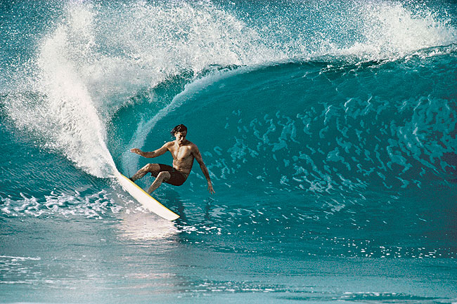
What does this have to do with student writing?

Slide 11
Huh? Now he’s talking about David Bowie???

Slide 12
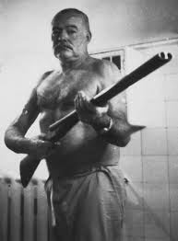
Okay…now I feel better.

Slide 13
How about You?
When have you copied, imitated, borrowed, or studied the work of an expert so that you could learn a skill?

Slide 14
Quick Read: “Making the Most of Mentor Texts”
I read.
We Jigsaw (4 minutes)
We Share/ Discuss
You write – Jot down one idea you have for using this technique in the classroom.

Slide 15
Use mentor texts in conjunction with performance standards.

Slide 16
What/Who VS. How
1. Who is the main character?
2. How does the author reveal the personality of the main character?
3. Using the novel’s first chapter as a model, write a short piece that reveals a character in the same way.
4. Present your finished piece to your partner and discuss how you both achieved your goal.
5. Be prepared to share your ideas with the class.
What is the author’s tone?
2. How does the author make his tone evident?
3. Using the article as a model, write a personal paragraph in which you demonstrate the same tone.
4. In a group of 3, discuss your paragraphs, identify all the words you see that signal the tone to the reader.
5. Write your list of tone words on the board.
What is the structure of the speech?
How does the author develop his argument?
3. Using the speech as a model, write your own speech on something you believe and use the same rhetorical device.
4. Practice and present your speech aloud to the class.

Slide 17
Search for Balance in the Classroom
For every 5-8 minutes you talk, give them 1-2 minutes to talk to each other. You can walk around and listen, informally assessing and checking for understanding.
Provide a model of great reading and writing by reading and writing WITH your kids every day.

Slide 18
Try This!
“I wondered if that was how forgiveness budded; not with the fanfare of epiphany, but with pain gathering its things, packing up, and slipping away unannounced in the middle of the night.” ― Khaled Hosseini, The Kite Runner
WHAT is the main idea? HOW does the author make this idea vivid and clear for the reader?
WHAT is the feeling/mood of this sentence? HOW does the author create this feeling/mood.
WHAT rhetorical techniques are used? How does the author help us picture the action?
Now, write a sentence about teaching or learning or even about a topic of your choice that mimics the writing strategies we discussed.

Slide 19
Balance
“I wondered if that was how forgiveness budded; not with the fanfare of epiphany, but with pain gathering its things, packing up, and slipping away unannounced in the middle of the night.” ― Khaled Hosseini, The Kite Runner
I contemplated if that was how good writing sparked, not with the sexiness of a bolt of lightning, but with confidence gradually revving up, flickering a little before finally allowing in the calm of confidence like turning on the headlights amid a midnight downpour. Me, Right Now

Slide 20
Another One?
In the late summer of that year we lived in a house in a village that looked across the river and the plain to the mountains. In the bed of the river there were pebbles and boulders, dry and white in the sun, and the water was clear and swiftly moving and blue in the channels. Troops went by the house and down the road, and the dust they raised powdered the leaves of the trees. The trunks of the trees too were dusty and the leaves fell early that year, and we saw the troops marching along the road and the dust rising and leaves, stirred by the breeze, falling and the soldiers marching and afterward the road bare and white except for the leaves. Ernest Hemingway - A Farewell to Arms
Examine sentence structure. How does the author move the images along in the mind of the reader?
How does the writer use punctuation and transitions to move his ideas along?

Slide 21
Another Level?
In the late summer of that year we lived in a house in a village that looked across the river and the plain to the mountains. In the bed of the river there were pebbles and boulders, dry and white in the sun, and the water was clear and swiftly moving and blue in the channels. Troops went by the house and down the road, and the dust they raised powdered the leaves of the trees. The trunks of the trees too were dusty and the leaves fell early that year, and we saw the troops marching along the road and the dust rising and leaves, stirred by the breeze, falling and the soldiers marching and afterward the road bare and white except for the leaves. Ernest Hemingway - A Farewell to Arms
Now, using the punctuation and sentence structure we discussed write a paragraph that describes a place you have been.

Slide 22
Balance!
In December two years ago we stayed in a little hotel in the town of Bolzano, Italy that gazed into a valley between two snow-dusted mountains in front of a lead gray sky. Along the edge of the valley there were farm houses and rustic barns, wooden and damp in the mist, and the stone street just below our second floor window streamed with the comings and goings and locals and tourists alike. A train in the distance rattled past and passed into memory, and its metal motion ringing through the branches of the trees. The trees sagged under the weight of air’s condensation and leaves looked tired that morning, and we watched a red cable car climbing into the sky and the day warming and the clouds lifting, spurred by the wind, swirling and the visitors marching off to their adventures and afterward the cafés quiet and barren except for the dishes clanking in sinks.

Slide 23
For Social Studies?
We the People of the United States, in Order to form a more perfect Union, establish Justice, insure domestic Tranquility, provide for the common defense, promote the general Welfare, and secure the Blessings of Liberty to ourselves and our Posterity, do ordain and establish this Constitution for the United States of America.
How might you use this as a mentor text?

Slide 24
For Math?
Two boats on opposite banks of a river start moving towards each other. They first pass each other 1400 meters from one bank. They each continue to the opposite bank, immediately turn around and start back to the other bank. When they pass each other a second time, they are 600 meters from the other bank. We assume that each boat travels at a constant speed all along the journey. Find the width of the river?
How might you use this as a mentor text?

Slide 25
What are your kids reading now/next?
HOW might you use this approach in your class?

